Slide 1
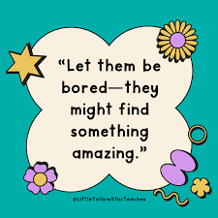
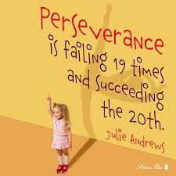
Developing Emotionally Resilient Children

Slide 2

What is Resilience?
Resilience is the ability to bounce back from difficult or challenging situations.

Slide 3
Lack of Emotional Resilience
Many children lack resilience and feel overwhelmed by life for a variety of reasons.
Growing concern about the declining resilience of children
Our culture may condition people to believe that they shouldn’t have to struggle.
Children today appear less willing to persist when tasks become difficult.

Slide 4
Why is this?
World seems a more dangerous place
COVID changed our behaviours
Screens / social media affecting emotional resilience
Change in parenting – ‘helicopter’ parenting replacing previous generation of dismissive ‘suck it up’ parenting

Slide 5
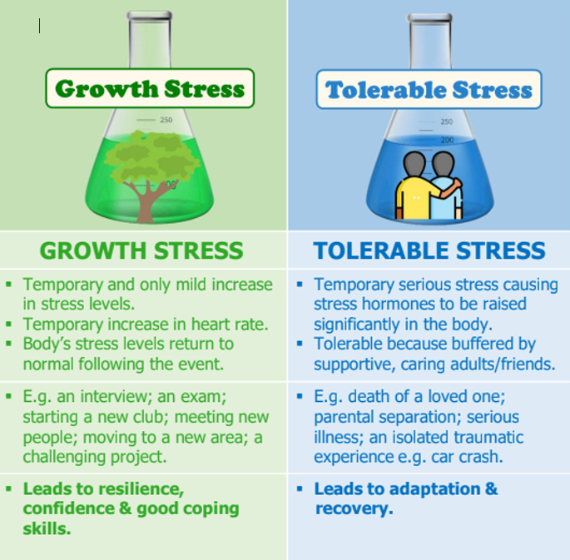
1. Children experience less unstructured challenge
Children expect instant fixes to uncomfortable feelings
We need to teach emotional resilience by teaching children to sit in their ‘tolerable’ stress zone or ‘growth’ zone more often
Children need to experience being bored and managing that feeling
Opportunities for free play which is unstructured

Slide 6
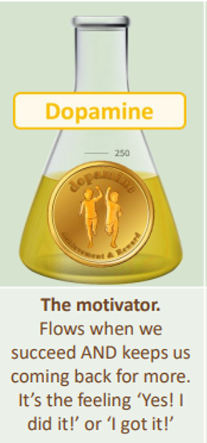
  2. Instant gratification is everywhere
  No sense of boredom
  Use of screen time for Dopamine fix
  Unable to get the same quick fix away from screens – poor concentration and focus seen in classrooms

Slide 7
  3. Fear of Failure
  Children seem less keen to put themselves out of their ‘comfort zone’
  Pressure to succeed – not coping with setbacks or failure

Slide 8
  4. Reduced opportunities to build resilience
  Changes in parenting
  Children need to experience failure and setbacks in order to grow
  Difficulty and discomfort build resilience and character

Slide 9

Jo Frost – SuperNanny / Parenting Coach
https://www.instagram.com/reel/DZZJ6VCN9W1/?utm_source=ig_web_button_share_sheet

Slide 10
How do we support?
Empowerment Approach – teaching children to understand their brains – how to get their needs met in helpful ways – how to build skills.
Learning about being resilient – coping with life
Ensuring that children can develop with effective boundaries around sleep, diet, exercise, healthy connections with others

Slide 11
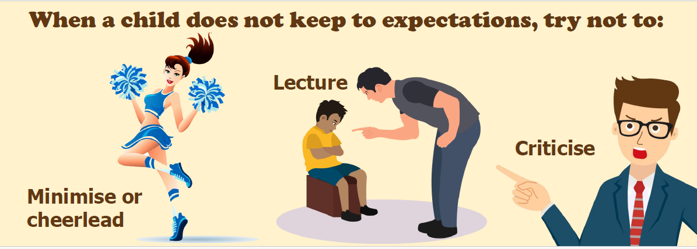
Validate feelings but maintain boundary

Slide 12
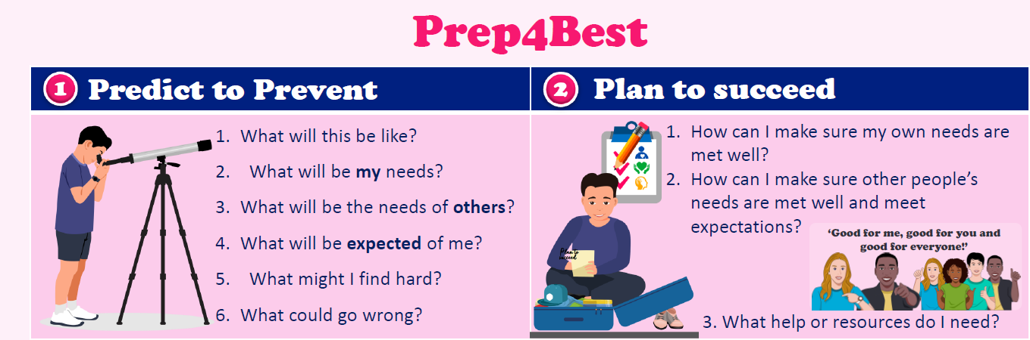
Prep4best
Getting your child to understand their needs
How can they support themselves and how can we as parents/carers support this.
Understanding from previous experiences what went wrong and what we can put in place on this occasion.

Slide 13
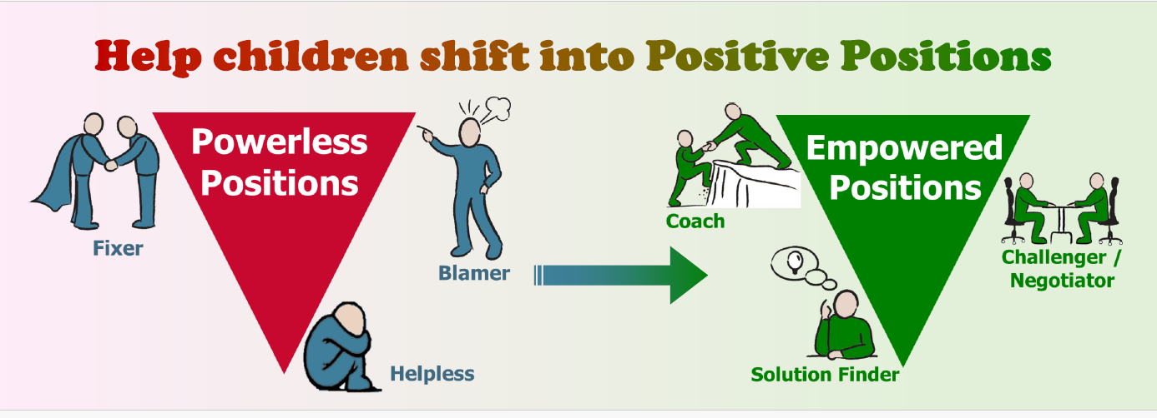
Plan to Succeed
Our job is not to fix but to coach.
We are working towards a pathway of independence.

Slide 14
Takeaway Top Tips
Allowing children to feel disappointed or fail teaches them to adapt when things don't go their way.
By removing all obstacles and making everything "better," parents fail to prepare children for the natural hurdles of the real world.
Instead of instantly fixing a child's problem, parents should offer their ears and empathy, teaching children how to process uncomfortable emotions
Difficulty and discomfort can build resilience and character.

