Slide 1




You’re Already Doing Enough!
Coffee Morning

Slide 2

Before we start, I want you to take a breath.
Not a ‘school-run breath’
Or a ‘what’s-for-dinner’ breath…
Just a normal one.
If you’ve ever wondered whether you’re
doing enough as a parent — this talk is for you.

Slide 3
The truth is… most parents who worry about doing enough are already doing more than enough.
Parents today are parenting in a very loud world.
Social media
Advice everywhere
Comparison with other families
It can feel like if we’re not actively improving our children every moment, we’re somehow falling behind
That’s exhausting!!!!!

Slide 4
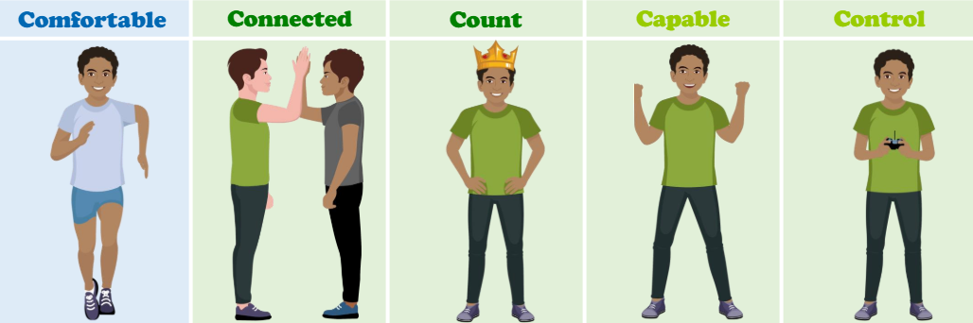
The Power of ‘Enough
Good enough parenting isn’t a backup plan — it’s the goal.
Children learn resilience not from perfect adults,
but from real ones.
Adults who repair
Adults who apologise
Adults who rest and come back

Slide 5
What Children Actually Need
Children don’t need perfect parents.
Children already have what they need.
Present → You notice them – actively listen – no need to always rescue.
Predictable → They know roughly how you’ll respond.
Safe enough → They can be themselves without fear of losing you.
These things shape children’s nervous systems, confidence, and sense of belonging.
And they’re built in ordinary moments — not special ones.”
They remember how it felt to be with you.”

Slide 6
Make sure your own 5C Needs are met!
Most parents have a voice in their head that says,
‘I should be doing more.’
But here’s a more useful question:
More of what — and according to whom?
“I’m doing what I can with what I have today.”
“My child needs me, not an upgraded version of me.”
“Rest is not a reward — it’s part of being a steady adult.”

Slide 7

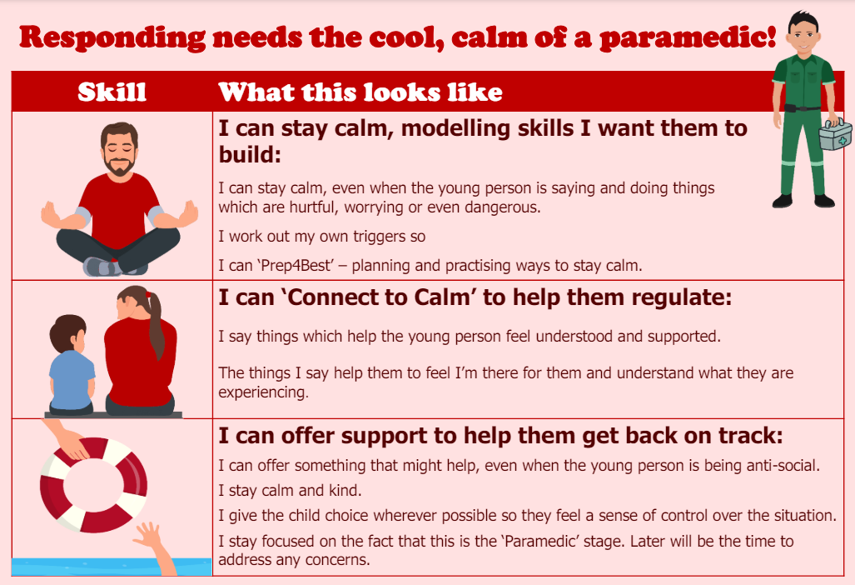
‘Connect to Calm’
Children don’t always need you to ‘rescue’ or ‘fix’ situations….but they need to feel heard.
Phrases used in school to ‘Connect to Calm’ include;
-It must be…
-I can see…
-I recognise…
-I wonder if…
-I notice…
All of this with curiosity and kindness at the centre – trying to understand ‘why?’ Be the child’s pre-frontal cortex

Slide 8
‘Connect to Calm’
Emotion Coaching supports a child to feel noticed and heard without the need to fix or rescue in the moment:
1. Validation & Acknowledgment
"I can see you’re feeling really upset right now, and that’s okay."
"It makes sense you’d feel that way after what happened."
"Your feelings are important, and I’m here to listen.“
2. Naming the Emotion
"It sounds like you’re feeling frustrated because things didn’t go as you hoped."
"I think you might be feeling nervous — is that right?"
"You seem really excited about this — I can tell it matters to you.“
3. Guiding Toward Regulation
"Let’s take a deep breath together and figure out what we can do next."
"I’m here to help you work through this step by step."
"What’s one small thing we can do right now to help you feel better?"

Slide 9
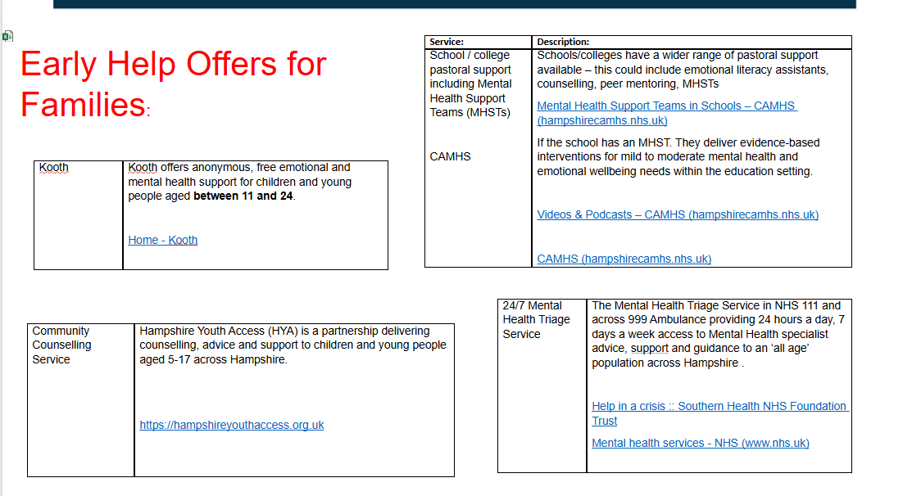

Slide 10


