Slide 1


Festive Family Coffee Morning

Slide 2
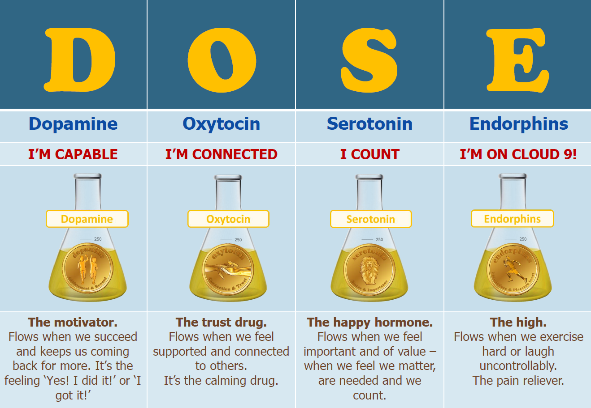

Slide 3
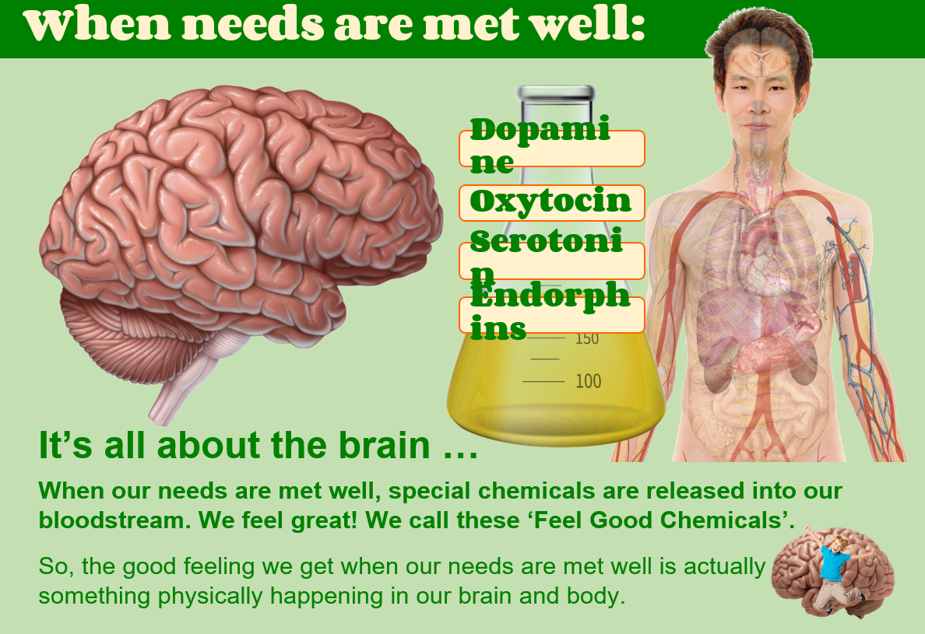

Slide 4
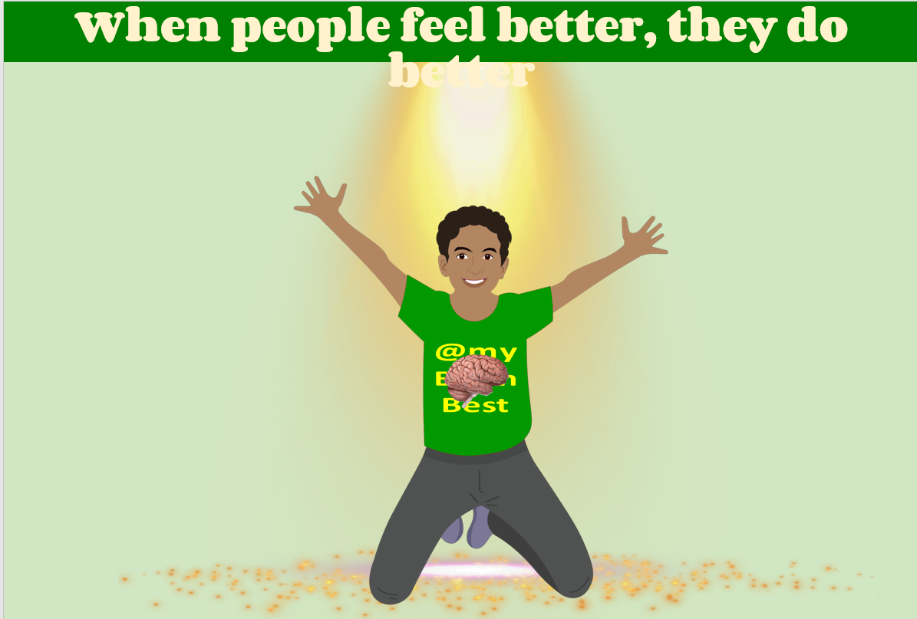

Slide 5
Feeling Connected
Share a warm drink or snack
• Read a story together
• Go for a winter walk
• Do a festive craft activity
Reduce rush and stress
• Focus on being present
• Celebrate small moments of joy

Slide 6
We can’t wait to see you all again next term!

