Slide 1
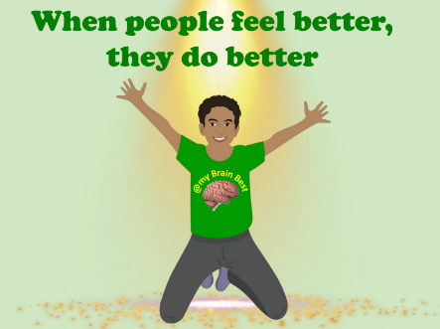
Supporting Children’s Wellbeing
5C Needs

Slide 2
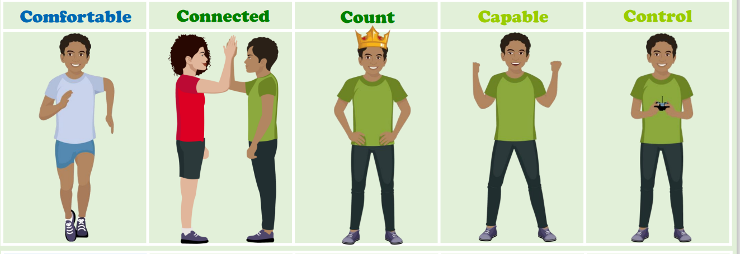
Being at our Brain Best
When our 5C Needs are met, then we can be at our ‘Brain Best’ for learning and play.
We can support children to understand how to feel good in a way which is good for everyone.

Slide 3
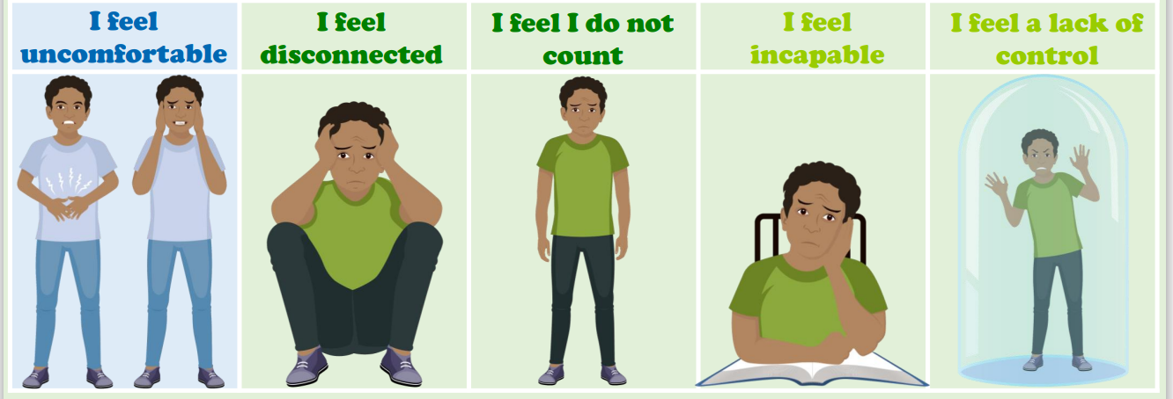
5C NEEDS
Our 5C Needs can be grouped into our physical, emotional and learning needs.
By teaching our 5C Needs, we can help children recognise when their needs are not being met and how they manage their ‘prickle’ feelings in a way which is good for everyone.

Slide 4
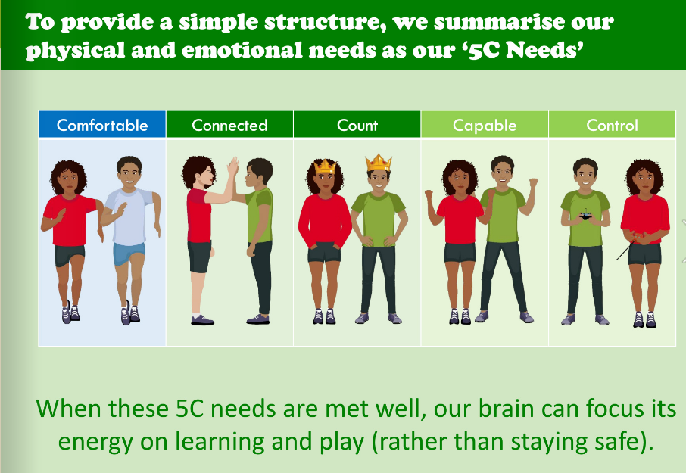

Slide 5
Feeling Comfortable (at home)
What it means: feeling safe, secure and calm so learning can happen.
  Predictable routines and clear expectations.
  A consistent bedtime and a quiet, safe space to unwind.
  Open conversations about feelings without judgment.
  What it means: strong relationships with family, friends and teachers.
  Daily one-to-one time and family traditions.
  Active listening and helping children build friendships
  Check-ins: ask about their day and listen.
Feeling Connected

Slide 6
Feeling ‘I Count’
What it means: feeling seen, heard and valued.
  Invite opinions and celebrate effort and contribution.
  Give roles at home (setting table, caring for pets).
  Acknowledge achievements small and large
What it means: belief they can try, learn and improve.
  Praise effort and strategies rather than perfection.
  Provide age-appropriate responsibilities and challenges.
  Encourage resilience: mistakes are part of learning.
Feeling Capable

Slide 7
Feeling In Control
What it means: having small choices and predictable boundaries.
  Offer limited choices to empower decision-making.
  Teach simple self-regulation strategies (breathing, count to 5).
  Use visuals or timers to help with transitions.

Slide 8
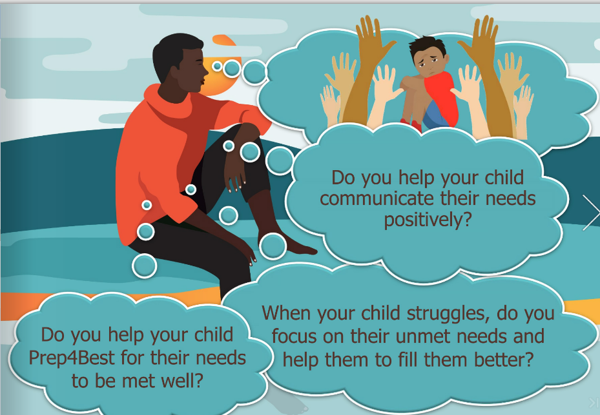

Slide 9
How to support Wellbeing at home…
  Small, consistent actions matter more than big fixes.
  Use routines, connection and choice to build safety.
  Celebrate effort and involve children in decisions.
  Talk about 5C Needs
  ‘Good for me, Good for you & Good for Everyone’
  The Wellbeing Shield is a home reminder of strengths.

Slide 10


