Slide 1
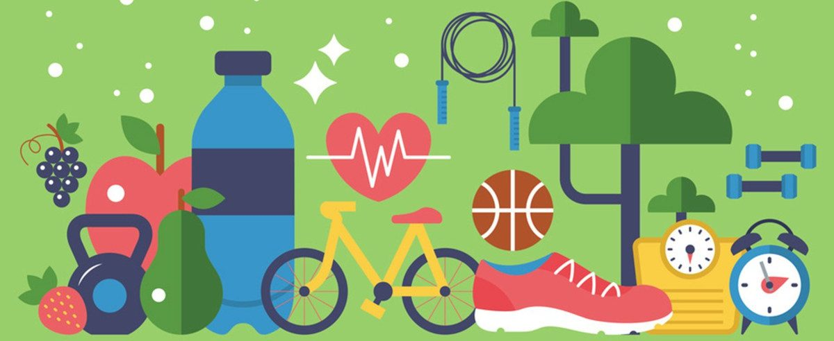
Healthy Habits

Slide 2

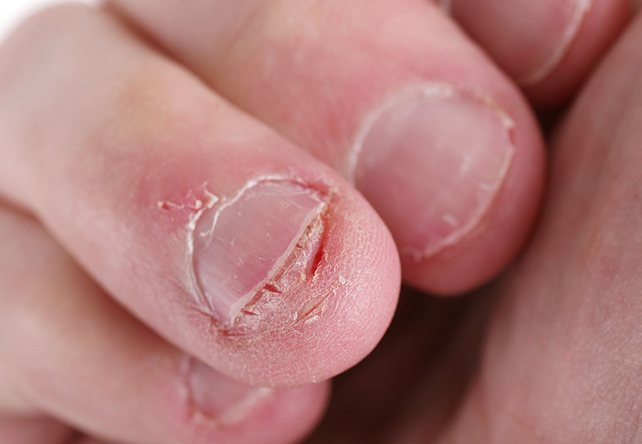
What is a Habit?
A Habit is something we do regularly or repeatedly without even thinking about it. Its like a routine or a behaviour that we have learned and it becomes a natural part of our lives.
Habits can be both good and bad
For example, you brush your teeth every morning and before bed
On the other hand, lets say you have a habit of biting nails

Slide 3

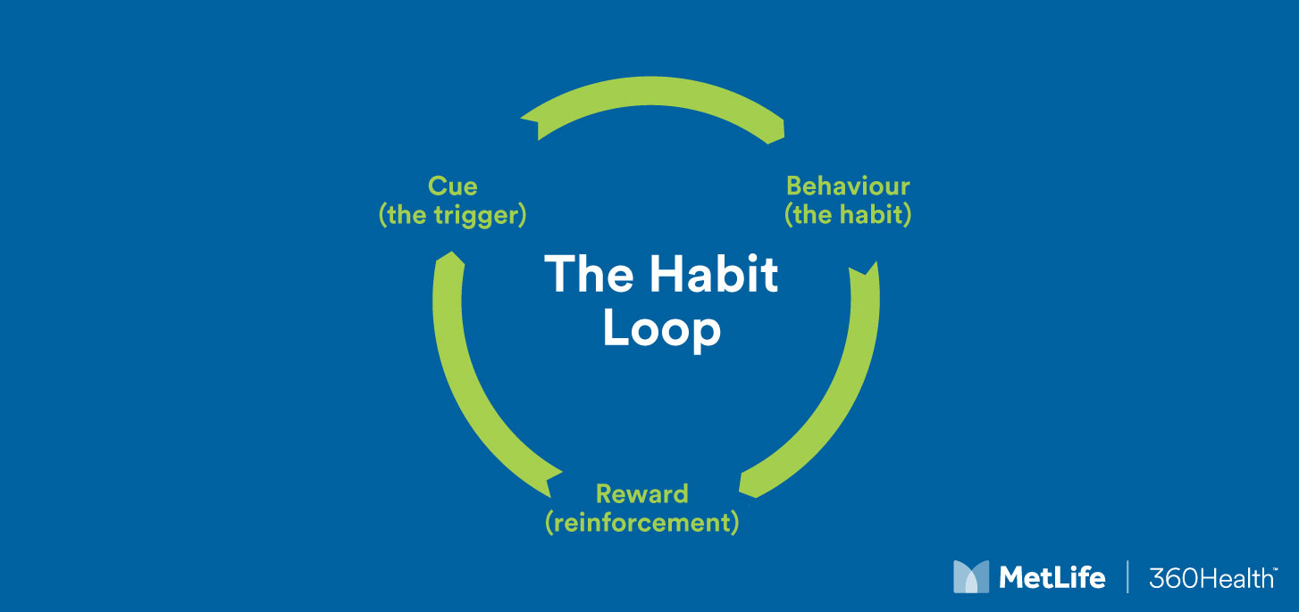
Habits can be formed through repetition and practice. When we do something over and over again, our brain gets used to it and it becomes a habit. That’s why its important to be mindful of the things we do regularly because they can shape our habits.
Its important to develop good habits because they can help us in many ways.
Good habits like eating healthy food, exercising regularly and being kind to others has huge positive effects on us.

Slide 4

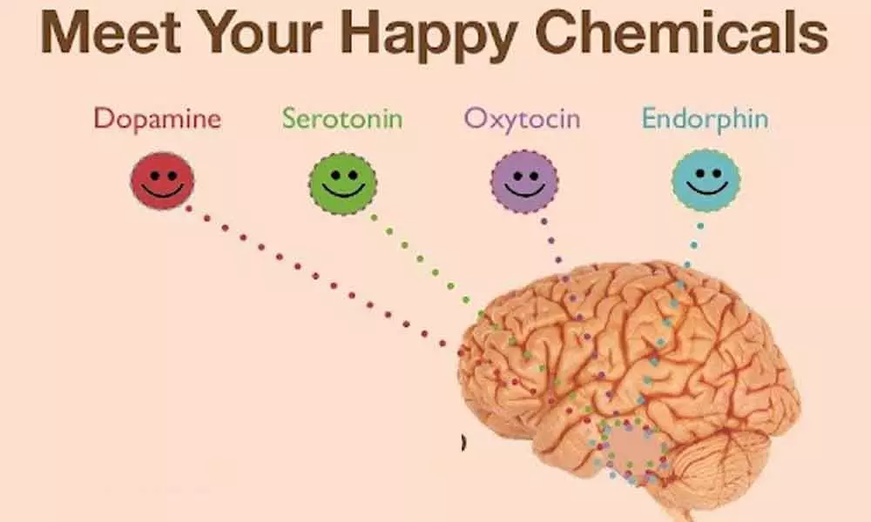

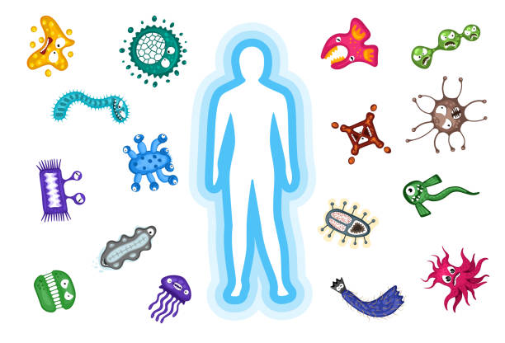
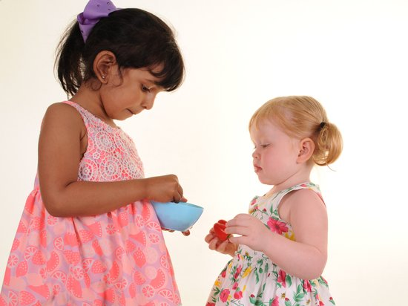
Why are healthy habits important
Strong and Healthy body:
Feeling Happy:
Better Focus and Learning:
Staying Illness-Free:
Setting a Good Example:

Slide 5




Healthy Habits

Slide 6
How we build Healthy Habits
Set Goals:
Plan and prepare:
Make it Fun:
Involve Friends and Family:
Be Mindful:
Celebrate Progress:

Slide 7

How do we support Healthy Habits in school?
Nutritious lunches
Physical Education
Healthy school environment
Education and awareness
Support of mental Health through strategies such as Trick box

Slide 8

But remember………………………………forming healthy habits takes time and consistency. Be patient with yourself and don’t be discouraged if you slip up occasionally. The key is to keep trying and making small improvements every day. With persistence, healthy habits will become a natural part of your day-to-day life.

