Slide 1
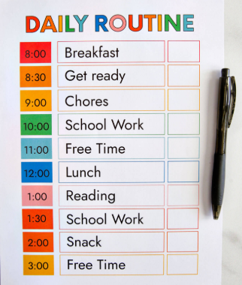
Supporting your child’s busy brain
Small changes big differences

Slide 2
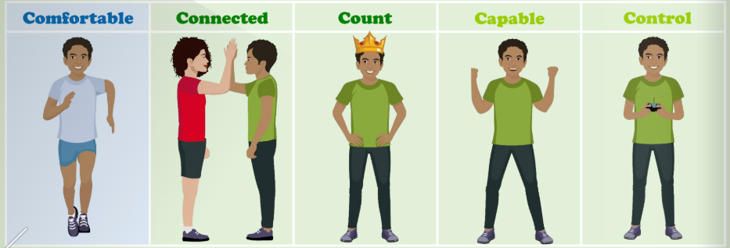
How we can support at home
Routines
Meeting their 5c needs

Slide 3
Visual aids
Downtime without screens
Sensory input (or rest)
Extra processing time

Slide 4
When its hard
Meltdowns = overload, not misbehaving
Masking is exhausting
They aren’t giving you a hard time – they're having one
Whats helps
  Empathy
  Consistancy
  Recovery time (for both of you)

Slide 5
You are the expert on your child
No one size fits all
You calm, your love and your advocacy matter
Support looks different in every home

Slide 6
To Takeaway
Busy brains need support, not fixing
Brain fit and 5C needs give a helpful framework
You are not alone – community and tools help.

Slide 7


