Slide 1

Sleep Support in school aged children
Hampshire 0-19 Team
And Children’s Wellbeing Service
Winchester, Eastleigh and New Forest

Slide 2

How we can help.
We can inform and support families parents about:-
The safer sleep messages for younger siblings.
Why sleep is important.
The impact of sleep problems on children.
How much sleep their child should be getting.
Common sleep issues in childhood.
Top Tips to help if children have settling issues.

Slide 3
What are the common sleep problems in your household?
Notes:
Cant get to sleep
Hungry/thirsty
Worried
Over tiered
Scared Nightmares
Nightmares usually occur during REM sleep. They can happen at any age, and may lead to sleep resistance due to fear of the dream recurring. For children, even normal events — such as starting school, new siblings, moving or travel — can create nightmares.
Why Your Kid Won’t Go to Sleep
Common reasons your child might not go to sleep include:
A power struggle
Bedroom set-up
Being overtired
Caffeine consumption
Excessive electronics usage
Fear of the dark
Feeling left out
Hunger
Inconsistent bedtime
Lack of bedtime routine
Lack of transition
Overstimulation
Wondering if your there
Used to getting up
Wanting to ask you a question
Needing you in the room
Reassurance who’s in the house
Control
Overstimulated-play/gamming/friends over
Needs a wee
Lack of consistent routine
Caffeine
Change in routine and environment
Co-sleeping

Slide 4
Safer Sleep Principles and Key Messages
Co-sleeping and bed sharing is a very personal choice and some parents will chose to do this, our job is to inform parents about the safer sleep message and to advise them of when co-sleeping can be dangerous;
If either parent/partner smokes (even if they do not smoke in the bedroom)
If either parent/partner has drunk alcohol or taken drugs. This includes prescribed medications that may cause drowsiness.
If either parent/partner is extremely tired
If the baby was born premature (37 weeks or less)
If the baby was born at a low weight (2.5kg or 5½ lbs or less)
Co-sleeping on a sofa or armchair with a baby can increase the risk of SIDS by 50 times
Notes:
Include the safest place for a baby to sleep for the first 6 months is in a separate cot or Moses basket in the same room as parent/carer.
Babies need to sleep with their feet at the end of the cot/pram/Moses basket always ensuring their head and face are uncovered,

Slide 5
How can the 0-19 Team support sleep issues
Chat Health 0-5 - is a text messaging service set up to support parents, carers and families of under 5’s in Hampshire. Run by local Health Visitors and supported by Community Nursery Nurses who have a wealth of experience working with Mum’s and Dad’s –to-be, babies, toddlers and young children. 07520 615720
Chat Health 5-19 - This is a text service for parents of children 5-19, the Chat Health advisor team is made up of school nurses and supported by Community Nursery Nurses, again these nurses have extensive experience of working with and supporting parents of children and young people. 07507 332417
Chat Health 11-19 – is a simple, convenient and confidential text message service for young people in Hampshire aged 11-19, this is supported by school nurses who have extensive experience of supporting young people. 07507 332160
Notes:
Chat health is open from 9am – 4:30pm Mon-Thurs and 9am to 4pm on Friday, excluding weekends and bank holidays, any parent or young person who texts outside of these hours will receive an automated message with advice of where to get help if their question is urgent.
The team can support with questions relating to a wide range of health issues including healthy lifestyles, toileting, behaviour, sleep, emotional wellbeing and health conditions as swell as signposting to appropriate services and other support.
Chat Health 11-19, young people can be offered support with questions relating to self harm, relationships, bullying, weight concerns, anxiety, drugs, smoking, alcohol and sexual health and again as well as giving advice the team can signpost to other appropriate services and support

Slide 6

Why is children’s sleep so important?
Sleep is essential to support children’s development. Well rested children are more able to meet their full potential in every aspect of their lives.
Every living creature needs to sleep, Circadian rhythms, or the sleep-wake cycle are regulated by light
and dark, these rhythms develop at about
6 weeks and by three to six months most
infants have a regular sleep pattern.
Sleep is especially important for children
as it directly impacts their mental and
physical development.

Slide 7

Why is sleep important.
Notes:
Why is imported in your family home?
Struggling to get up in the morning
More irritable
Un well
Unhappy
School avoidance
Not meeting there basic needs

Slide 8
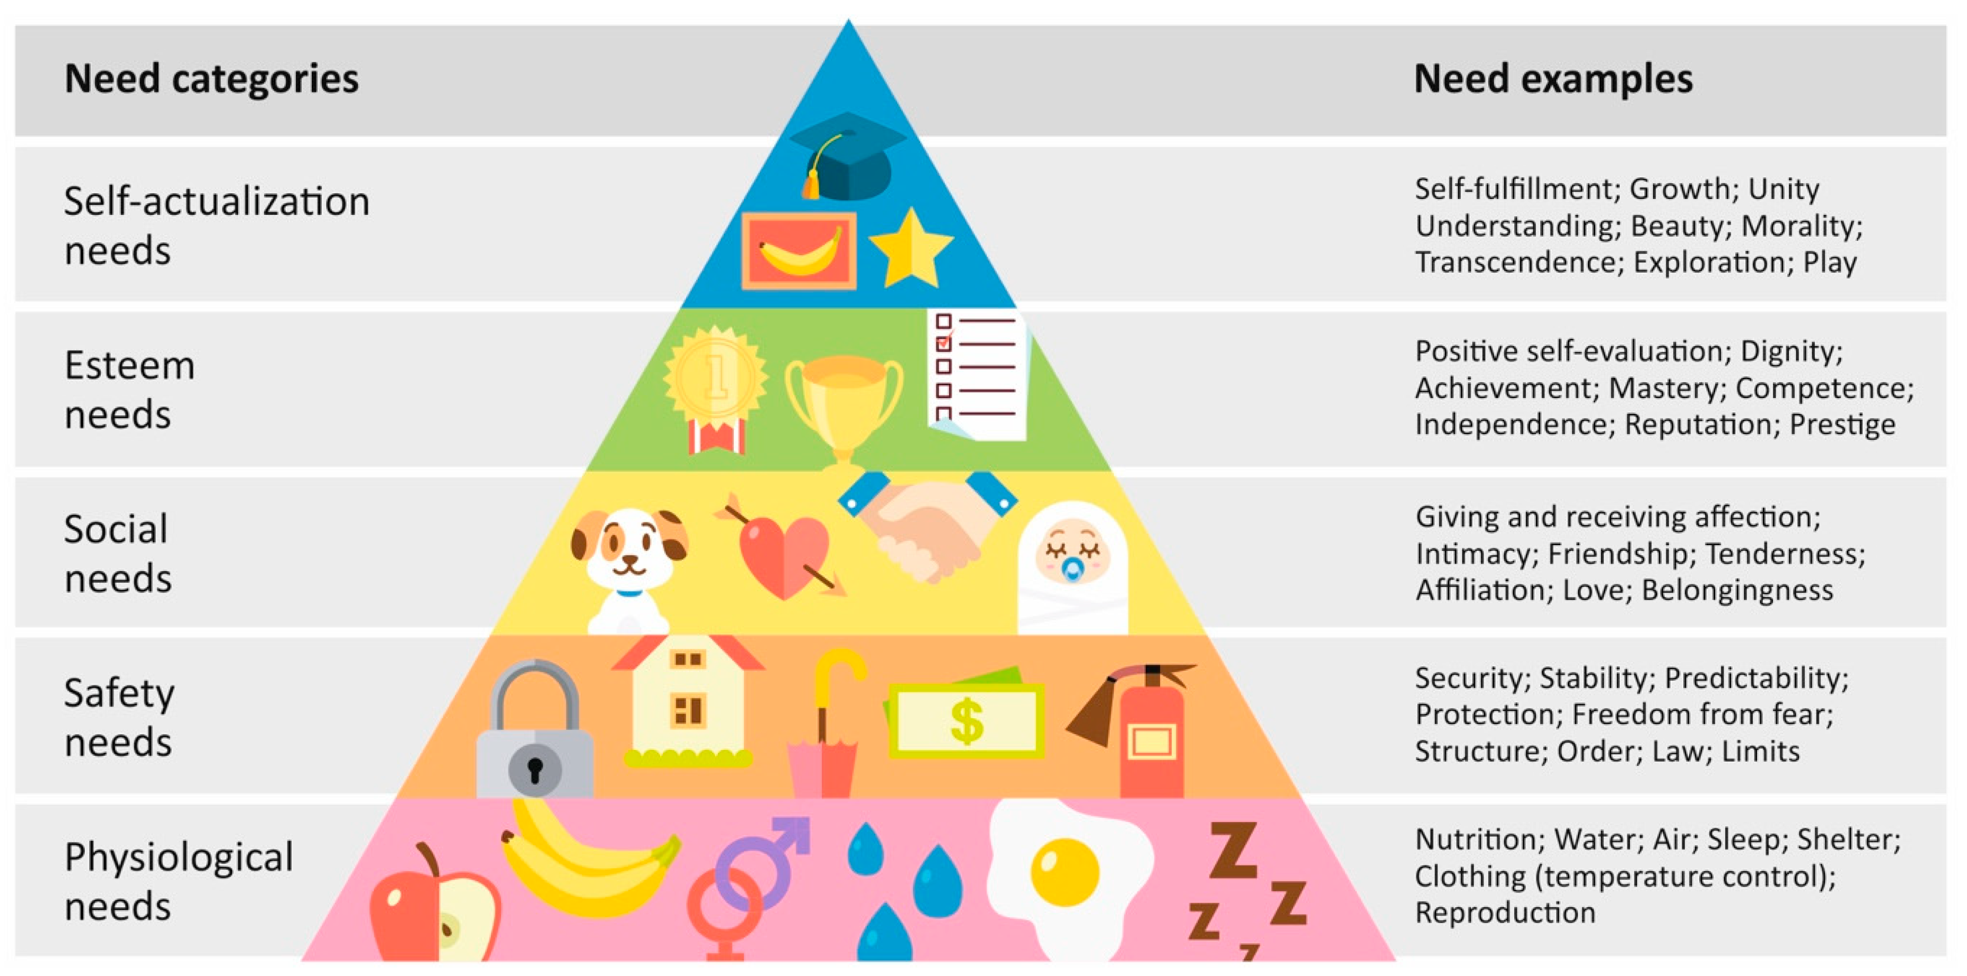
Maslow hierarchy of need.
Notes:
Importance of reaching there full potential

Slide 9
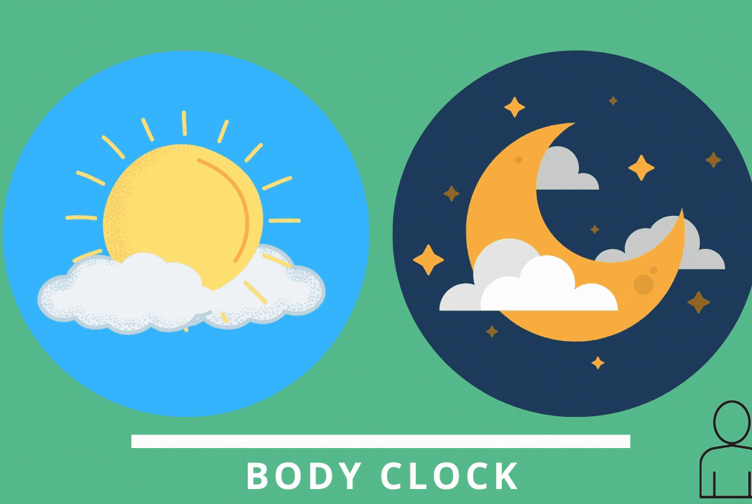
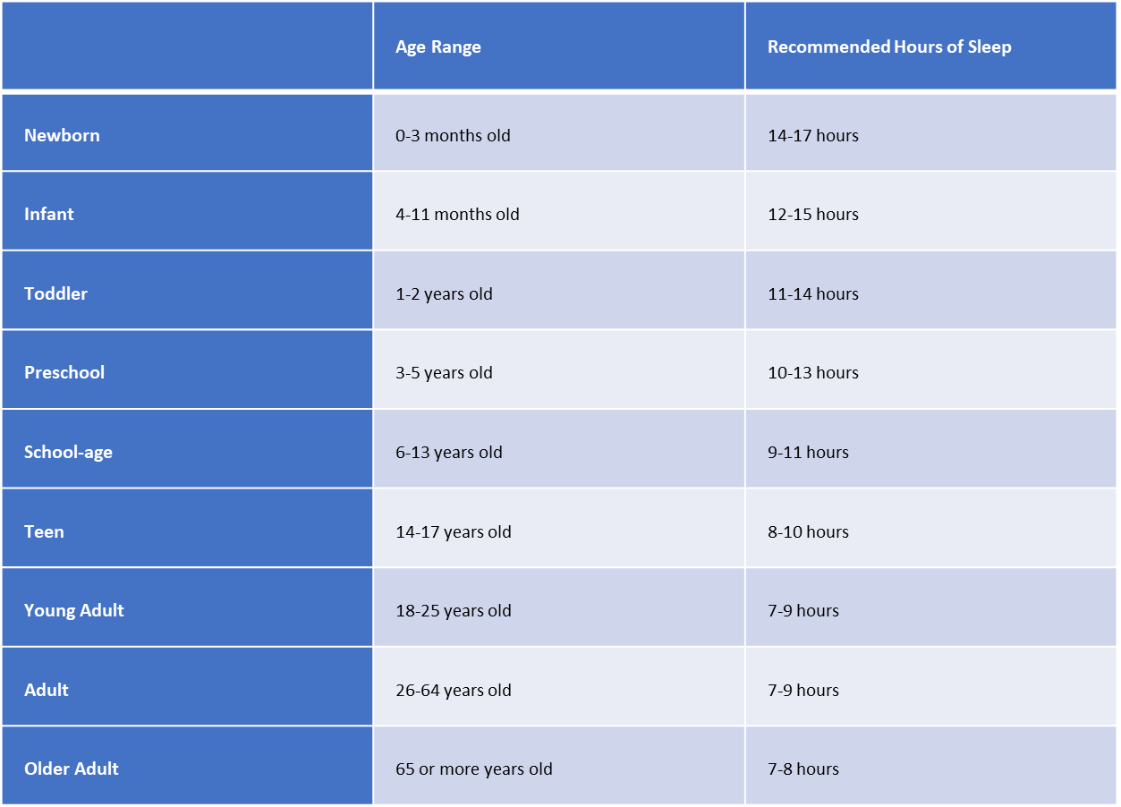
How much sleep is recommended for each age group?
Notes:
How much sleep does your children get?
Is that a problem in your house?
What are the adults sleeping habits?
Historically as parents, how did you sleep?

Slide 10
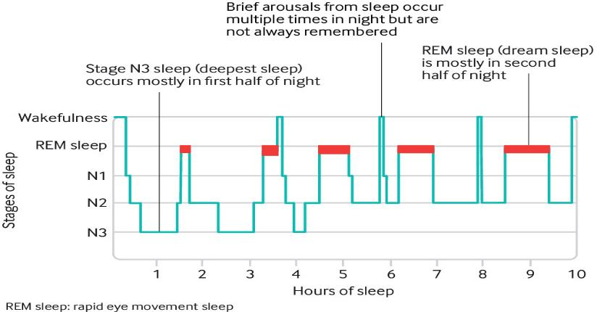
Hypnogram of a normal sleep pattern
Notes:
At night time we experience different levels of sleep and we sleep in cycles. REM (Rapid eye movement) and Non REM sleep are different stages but both essential to keep us healthy, this is an example of how these cycles occur. We get our deep sleep towards the beginning of the night and our lighter sleep is the early hours of the morning.
After each sleep cycle we come to a point of partial awakening.

Slide 11
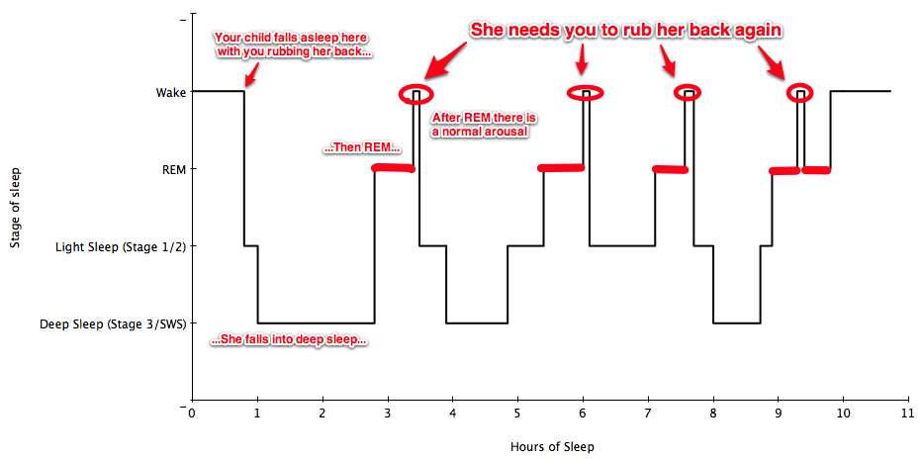
Hypnogram showing a child with a common sleep issue
(Sleep onset association)
Notes:
If everything is as it was when we fell asleep then we may just roll over and carry on sleeping. If anything has changed however… that’s when we wake up! This is why it’s important that a child’s sleep conditions remain the same through the night. A child who needs rocking to sleep or if you are laying or sitting with your child when they fall asleep then they are highly likely to wake after each cycle and need the same condition to be met to get them back to sleep.

Slide 12
Different Stages of sleep
Non-REM Sleep
Stage 1 – a very light sleep, where your child will be easily woken.
Stage 2 – still quite a light sleep but the body is preparing for a deep sleep.
Stage 3 – This is a very deep sleep. The body needs this sleep so that repair can take place
REM Sleep
REM sleep or rapid eye movement sleep as you may hear it referred to is when dreams occur. It is vital for mental and emotional development. Our brains can become very active during REM sleep yet our bodies are relaxed.
Notes:
Stage 1 – If you’ve ever tried tip toeing out of their bedroom and they’ve woken up then this is why – they were in a very light sleep.
Stage 2 – Your child will be more relaxed now and if you are trying to sneak out of their bedroom

Slide 13

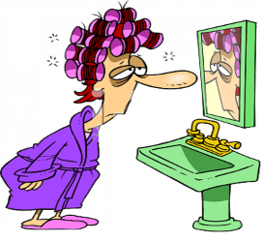
Impact of sleep problems on children (and their parents!!)
Lack of concentration
Reduced physical capability to recover from illness
Incorrect diagnosis of conditions such as ADHD
Daytime functioning
Academic performance
Poor Behaviour
Lethargy
Anxiety
Affects on development

Slide 14
Most common bedtime issues
Child getting up and returning to the living area after lights out – say ‘It’s bedtime’ and gently lead them back to bed, this may need to be completed more that one, staying calm is the key and being consistent.
Child getting into parents bed during the night – consider how the child fell asleep, did the parent sit with them, rub their back or lay with them? It’s natural for children to wake during the night, however if the environment is different this could be why the child can’t settle. Follow above advice.
Night Terrors – There is advice on NHS choices for this issue along with advice for dealing with nightmares. Being a watchful parent during these episodes to help keep them safe, try not to wake the child. If they are awake calm and reassure before returning them to bed.
Wake up siblings- it is helpful to teach our children, if they share a room, what they should do when they go to bed. When mum/dad have settled the children into bed and turned out the lights, it is time to sleep. Stay in the room, by the door with little interaction just to reassure them. If you do this consistently, you can then open the door and stand out side; this should lead to them getting used to this routine of self settling and going to sleep.
Notes:
A care plan with small achievable steps can be used with the family to address sleep issues.

Slide 15

What is helpful at bedtime?
Notes:
Regular routine-same time
Prepare for bedtime (dinner/calm activity bath bed)
The bedroom
Yoga/relaxation
Audio books music, mindful apps
White noise
A consistent bedtime routine is important as it teaches your child what to expect in the time leading up to bedtime.
All electronic devices should be turned off at least one hour before bedtime this includes T.V, computers, games consoles and mobile phones. The blue light from screens stimulates brain activity which delays the onset of sleep.
Help them to become involved in a quiet, relaxing activity such as colouring/drawing or building a jigsaw in the lead up to bedtime.
Baths are helpful but only if your child finds them relaxing. Ideally a bath should take place at least 30 minutes before bedtime.
The bedtime routine should last about 20-30 minutes and have an end-point which your child will know means it is time to go to sleep, such as turning out the light and saying goodnight and leaving the room.
Pre-empting what will be asked, create a check list pee food question

Slide 16


Slide 17
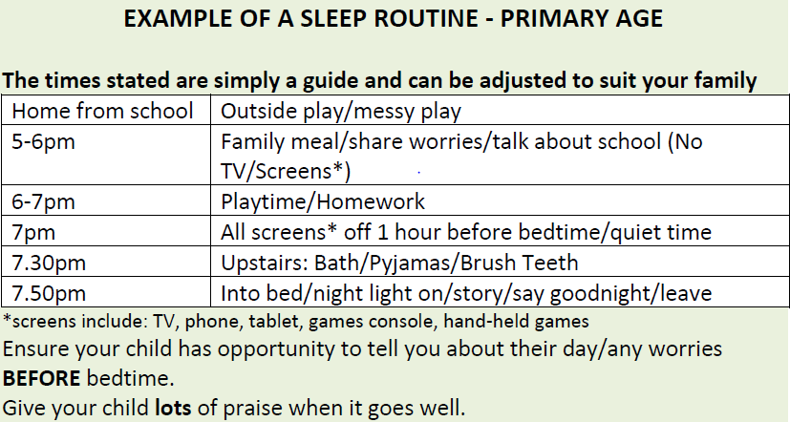
What does a bedtime routine look like?
Notes:
Using electronics just before bed and in the bedroom can keep us awake for longer as the blue light from these devices has the capacity to prevent the hormones that make us sleepy from being produced. Importantly, it is not just the light that can affect our sleep but most activities that we use our devices for can keep us awake and alert which we don’t want to do at bedtime

Slide 18
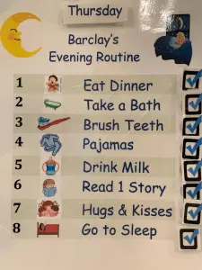
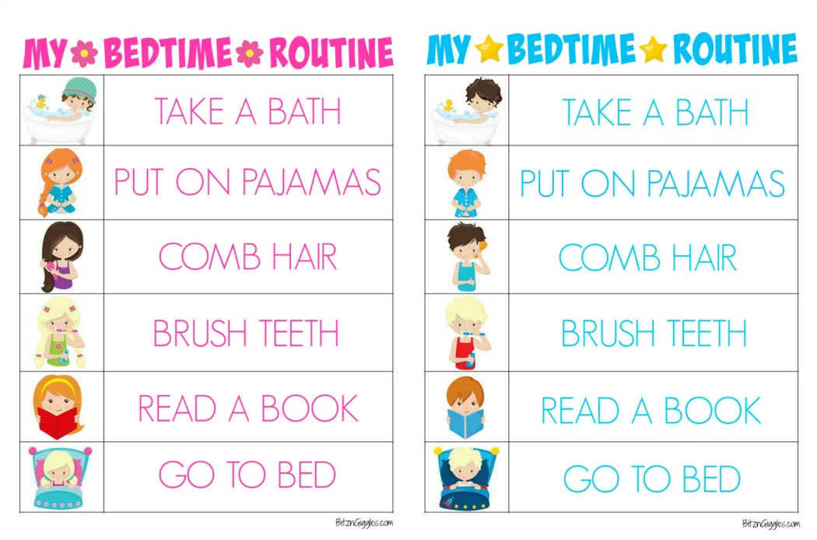
Examples of visuals for bedtime routine.
Notes:
Pre-ementing for change
Ooopppssss moments- parents not available

Slide 19

PLACE
Your attitude to the child is important. Dan Hughes spells out the qualities that can help children grow a healthy sense of themselves and make up the best background atmosphere for emotional learning :
P=Playful
L=Loving
A=Accepting
C=Curious
E=Empathic

Slide 20
Top Tips to share with families
Children who are physically tired will sleep better.
Spend quality time with your child before bed.
Avoid computers, TV or video games 1 hour before bed, mobile phones and tablets can also be an issue.
Be clear and firm about bedtime.
Ensure your child has had a small drink, brushed their teeth and been to the toilet.
Make the bedroom a warm, restful place to be.
Encourage your child to settle down and sleep in their own bed.
Be patient and involve others if you can for support for yourself.
Establish a good routine and stick to it consistently.
Give your child lots of praise when it goes well and acknowledge your child's efforts.
Notes:
Starting the bedtime routine at the same time every night will help children understand the pattern in the evening, follow this consistently.

Slide 21
Helpful websites to share with parents
Safer sleep advice - www.lullabytrust.org.uk/safer-sleep-advice
NHS Choices - www.nhs.uk/live-well/sleep-and-tiredness/healthy-sleep-tips-for-children
National Sleep Foundation- www.sleepfoundation.org/articles/how-blue-light-affects-kids-sleep
Common sleep problems – www.sleepcouncil.org.uk/advice-support/sleep-hub/family-matters/common-sleep-problems-in-children
Children with additional needs – www.sleepcouncil.org.uk/advice-support/sleep-hub/family-matters/children-with-additional-needs

