Slide 1
Playing Games

Slide 2
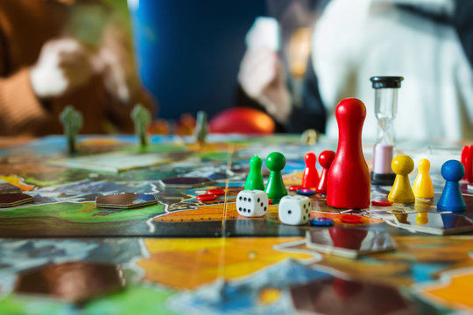
Benefit to playing games with your children
Helps us to:
Feel connected
Builds reliance
Reduces Stress
Regulates emotions

Slide 3
How this fits in with our 5c needs
Feeling Connected: Bonding between you and your child. Engaging in play encourages communication, cooperation, and social interaction
Feeling Capable : When you praise their efforts, creativity, or strategic thinking during the game, it reinforces their belief in their own abilities.
Feeling in Control: Following rules and taking turns helps children develop self-regulation, patience, and impulse control.
Feeling they Count: The game provides opportunities for them to contribute and be recognized
Feeling Comfortable: They feel safe, relaxed, and supported in the environment. Here’s how board games create this sense of comfort

Slide 4
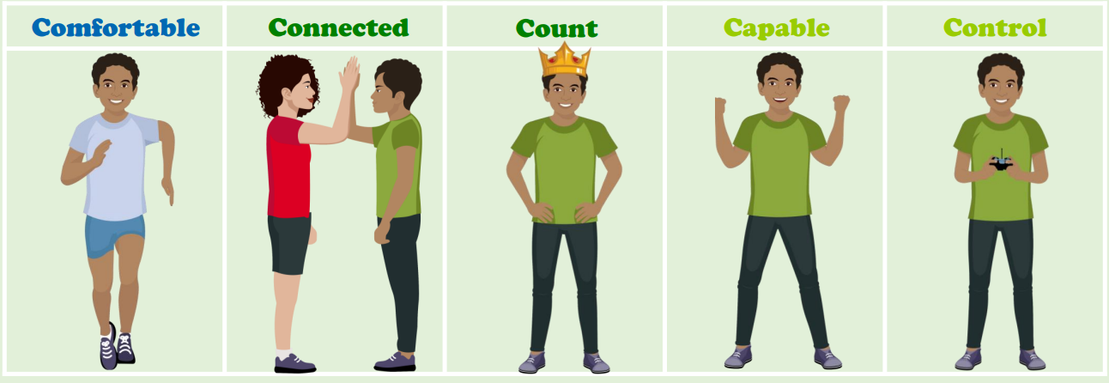
Our 5C Needs

Slide 5
Choosing the Right Games for Your Child
Ages 3-5: Simple games (Candy Land, Memory, Snakes & Ladders, shopping list games)
Ages 6-9: Strategy & logic (Uno, Connect 4, Guess Who, Dobble cards)
Ages 10+: Complex thinking (Chess, Clue, Ticket to Ride, Catan,

Slide 6
Tips for Making Game Time Enjoyable
🕰️ Set aside dedicated game time.
😊 Focus on fun, not just winning.
🎉 Encourage and celebrate effort.
🤝 Let kids choose games they enjoy.
💡 Model good sportsmanship.

Slide 7


