Slide 1
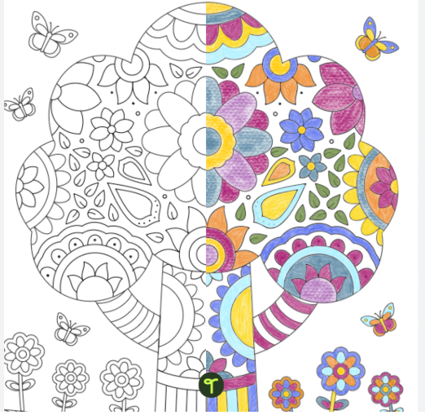
Mindful Colouring
Mindfulness Doodling – why it is good for you and your children

Slide 2
Introduction
The power of Doodling: A Mental Health Boost for both Parents and Children
How Drawing together enhances well-being and academic performance

Slide 3
The importance of Mental Health for Parents and children
Mental health is essential for overall well-being, happiness, and success in life.
For children, mental health is linked to their emotional development, ability to cope with challenges, and academic success.
For parents, maintaining mental health is crucial for being present and supportive in their children's lives.
Doodling as a shared activity can improve mental health for both.

Slide 4
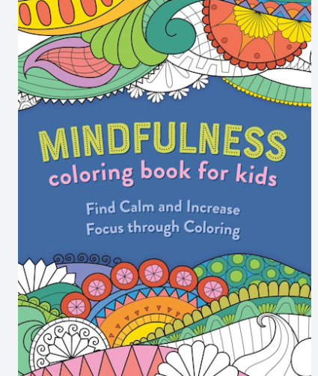
What is Doodling?
Doodling involves drawing simple, spontaneous images, or pattern often without a specific purpose.
It’s a form of creative expression, accessible to all ages and skill levels.
Common examples include spirals, squiggly lines, geometric shapes and abstract figures.

Slide 5
Mental Health Benefits for parents and children
Stress Relief
Doodling has been shown to reduce stress by helping to focus the mind and divert attention away from worries.
It is a low-pressure activity that doesn’t require precision or judgement
The act of drawing can trigger the release of dopamine, the 'feel-good’ chemical, promoting a sense of happiness and satisfaction.
Doodling together strengthens the emotional bond between parent and child.
Mindfulness
Engaging in doodling promotes mindfulness, keeping you both in the present moment, which is key for mental relaxation.
Doodling helps exercise the brain by improving memory, focus, and problem-solving abilities.

Slide 6
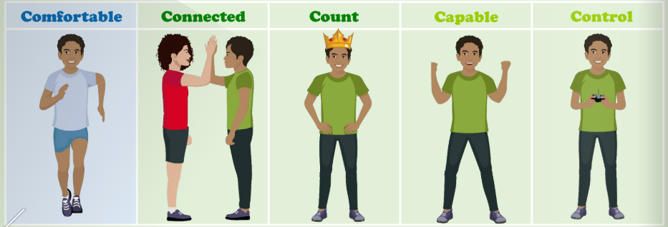
Brain Fit – Our 5c needs
In school we are teaching children how to manage their emotions and understand why they might be feeling a certain way. We want children to learn well and be independent in how they are able to use strategies to manage themselves and to feel that their needs are met.

Slide 7
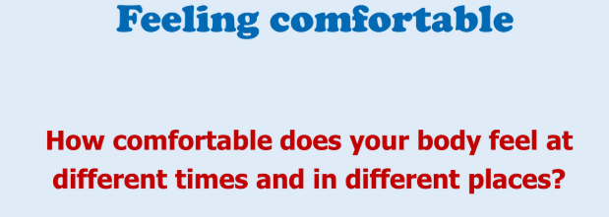
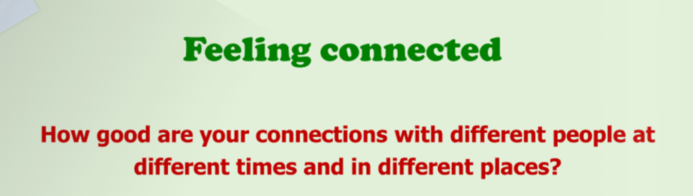
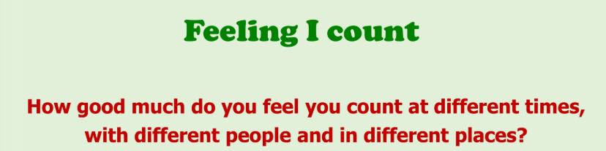
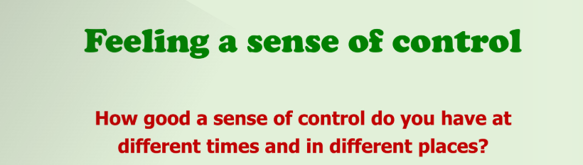
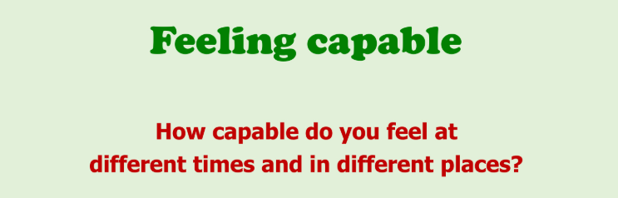

Slide 8
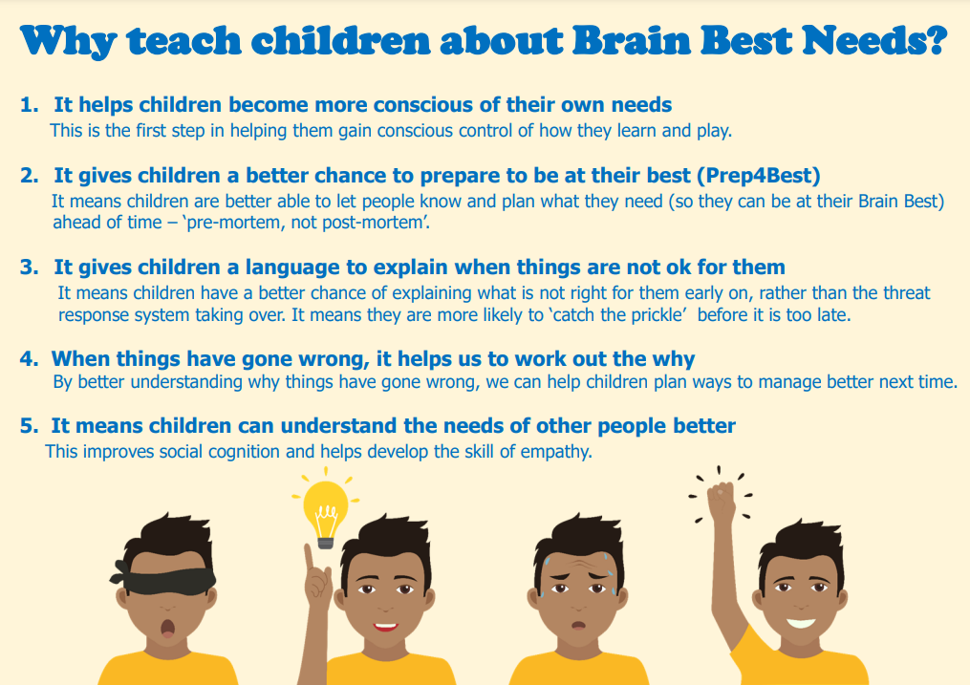

Slide 9
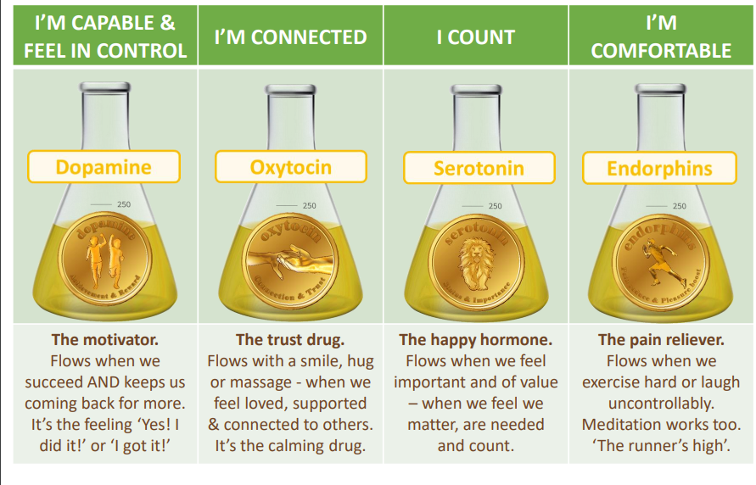
Mindful Colouring/Doodling helps to calm, allow you to remain in the present moment and supports our feel good chemicals.

Slide 10
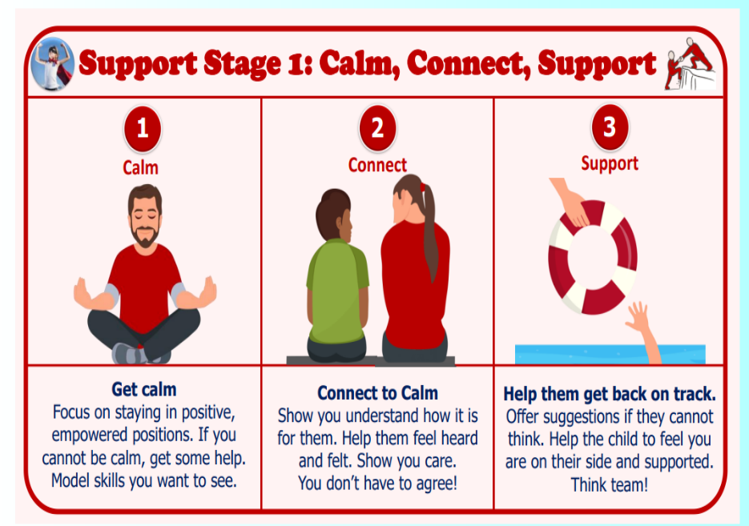

Slide 11
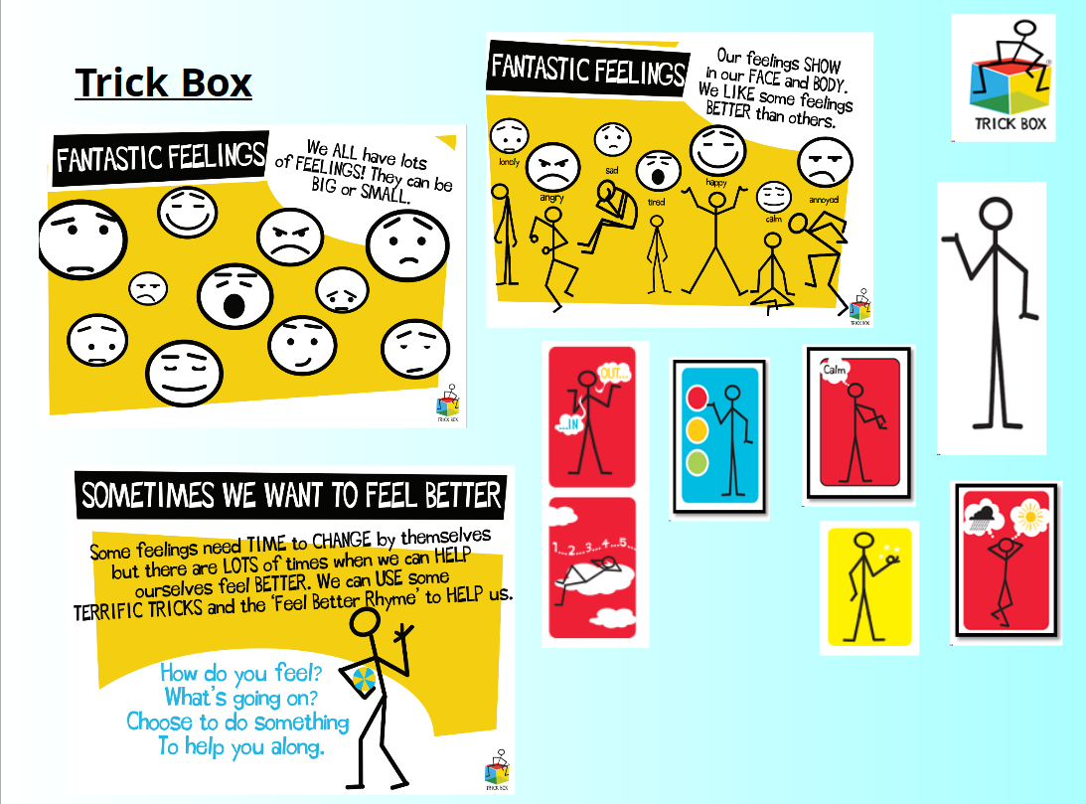

CALM Tricks:
Sunny Side
Floating Cloud
Breathing Colour
Magic Thumb

Slide 12
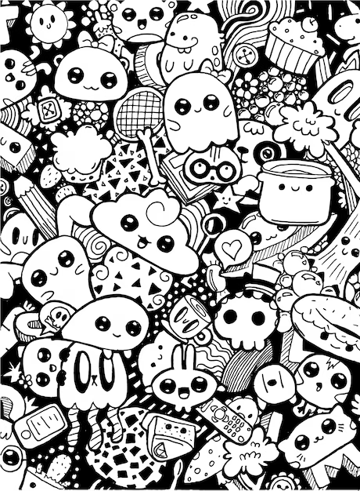
CONCLUSION
By embracing doodling as a tool for self-expression and mental health, both children and adults can fulfill these fundamental psychological needs, creating a healthier, happier mind and a stronger bond between you

