Slide 1
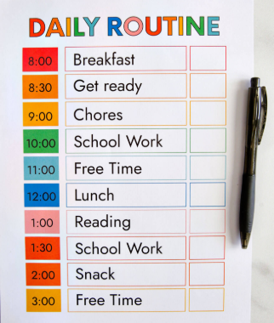
Building Resilience & Independence
Setting up good routines for children

Slide 2
Why Routines are Important
Routines are important for both children and parents because they create predictability which leads to security and can aid in developing self-discipline.
The same applies to children of all ages. Routines are much more powerful than just being the daily tasks that help you organise your day. Mealtimes, shopping, getting ready for bed - all create relationships and repetition to help children develop self-confidence, curiosity, social skills, self-control, communication skills, and more.
https://youtu.be/SNTKd-AXmo8

Slide 3
Why Routines Matter:
  Sense of Security: Children feel safe and confident when they know what to expect.
  Better Time Management: Helps children plan their day and manage responsibilities.
  Improved Behaviour: Structure can reduce stress and anxiety, leading to fewer meltdowns.
  Promotes Good Habits: Helps in developing long-term habits such as organisation, responsibility, and self-discipline.

Slide 4
Benefits of Building Independence in Children:
Self-Esteem: Completing tasks on their own boosts children's confidence.
Problem-Solving Skills: Children learn to manage challenges and make decisions.
Life Skills: Independence prepares children for success in school, work, and life.
Reduced Stress: Clear routines help children know what to expect, lowering anxiety.

Slide 5
Key Areas to Establish Routines:
Morning Routines Getting up, getting dressed, and eating breakfast.
School & Homework Time Setting a time for homework, studying, and breaks.
Chores & Responsibilities Assigning age-appropriate chores helps develop accountability.
Bedtime Routine Encourages good sleep habits and ensures proper rest.

Slide 6
How to Establish a Routine – KEY TIPS
  Consistency: Stick to similar routines every day (morning, bedtime, etc.).
  Visual Schedules: Use charts or calendars to help younger children track their routine.
  Flexibility: Be open to adjusting routines based on age, temperament, and needs.
  Involve Your Child: Let children contribute to the creation of their routines for ownership and engagement.

Slide 7
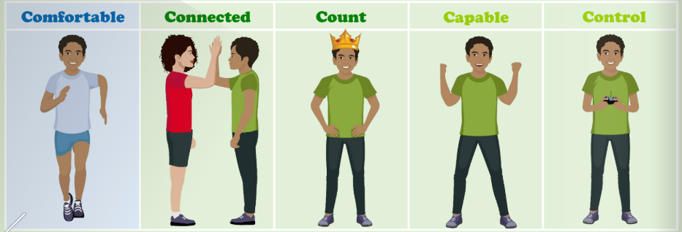
Brain Fit – Our 5c needs
In school we are teaching children how to manage their emotions and understand why they might be feeling a certain way. We want children to learn well and be independent in how they are able to use strategies to manage themselves and to feel that their needs are met.

Slide 8
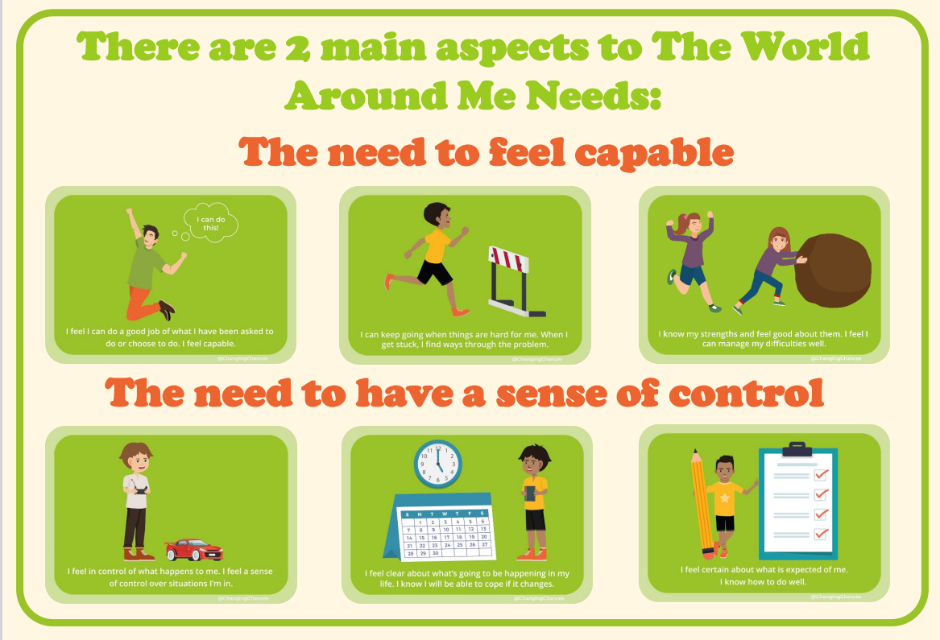
Brain Fit – Our 5c needs

Slide 9
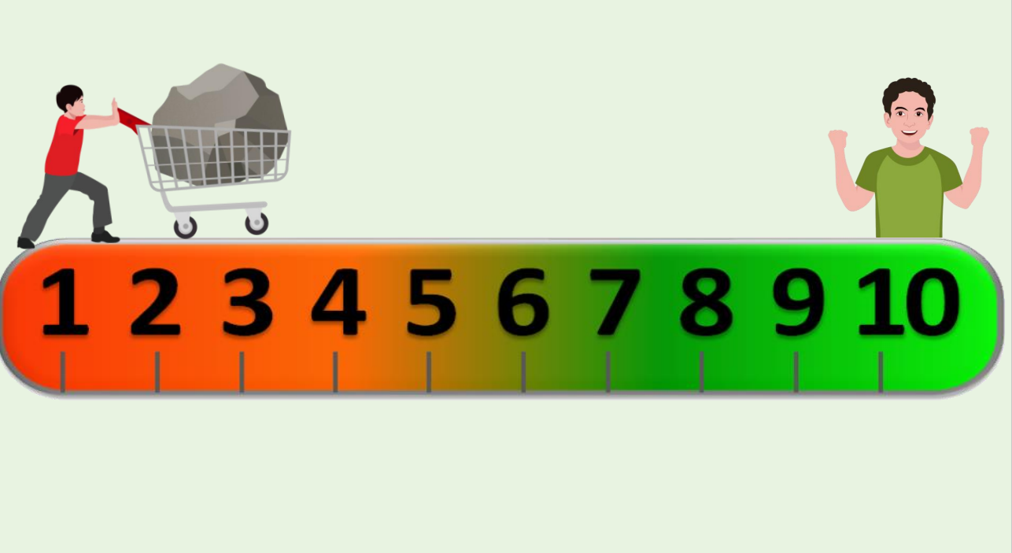
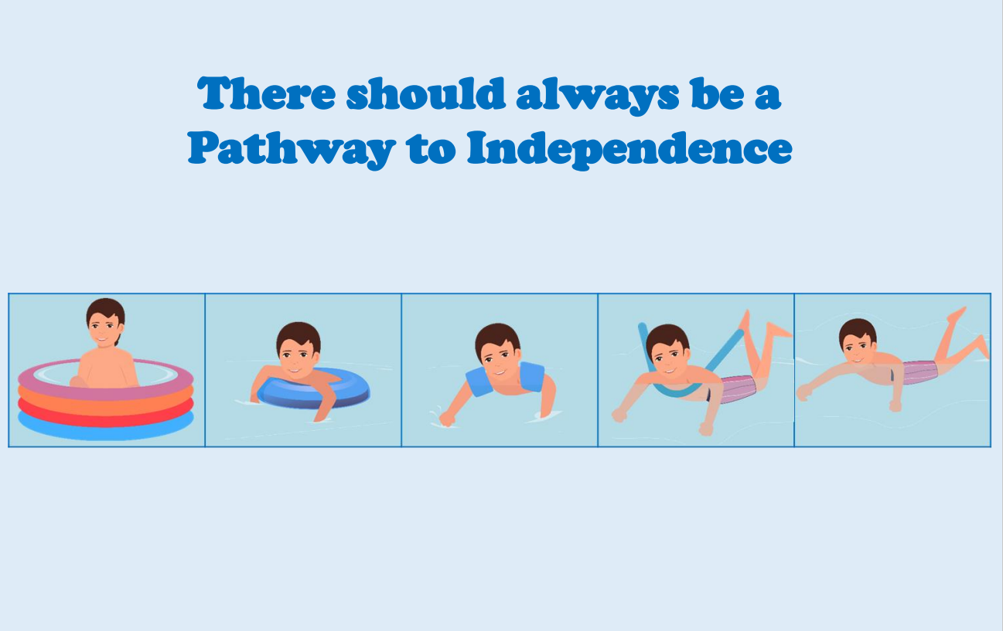
PATHWAY TO INDEPENDENCE:

Slide 10
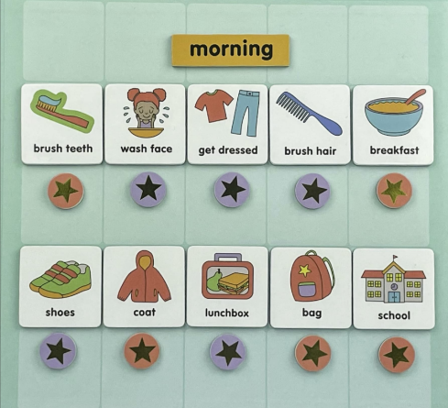
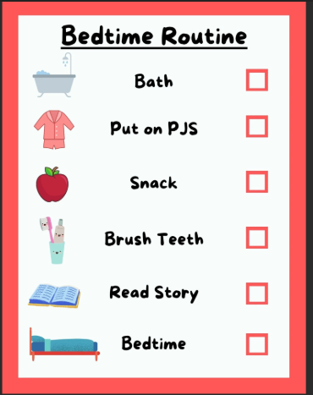
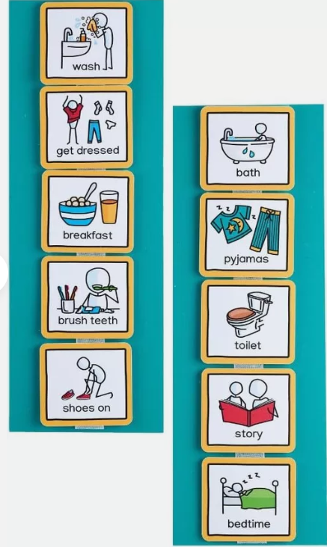

Slide 11
Common Challenges and Solutions
Challenge 1: Resistance to Change
Solution: Introduce small changes and make them fun, like a "new morning challenge”.
Challenge 2: Sibling Rivalry/Competition
Solution: Set individual expectations and celebrate personal achievement
Challenge 3: Lack of Motivation
Solution: Create a rewards system, but focus on intrinsic motivation by emphasising effort over outcome.

Slide 12
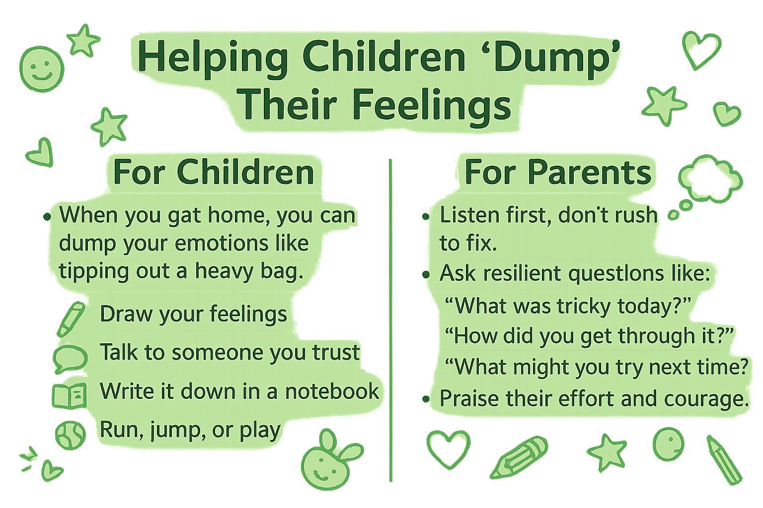

Slide 13
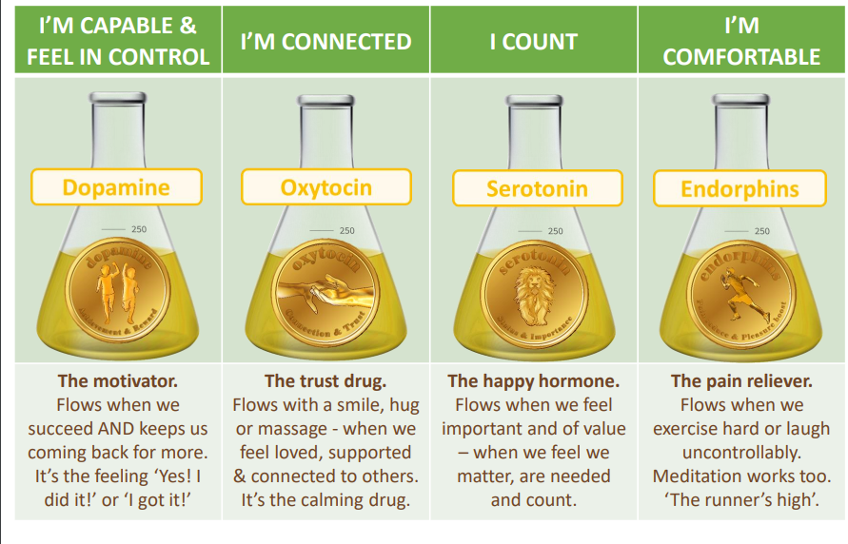

Slide 14

Fun Activity – Gratitude Jar
The purpose of a gratitude jar is to help you record and reflect on things you are grateful for. This practice can help you feel more positive, improve your mood, and boost your self-confidence.

Slide 15
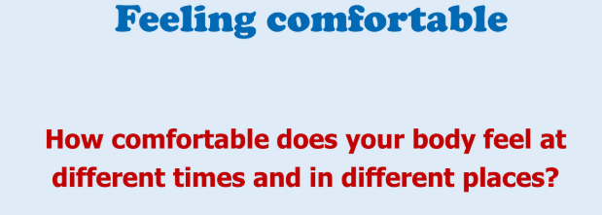
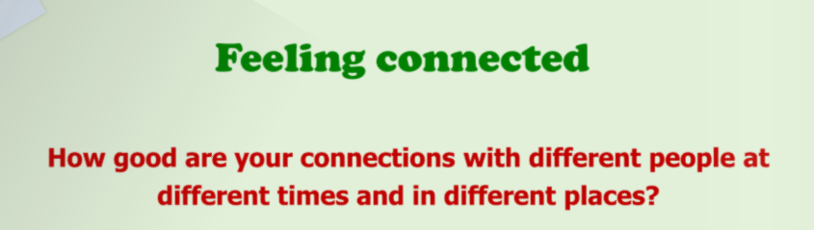
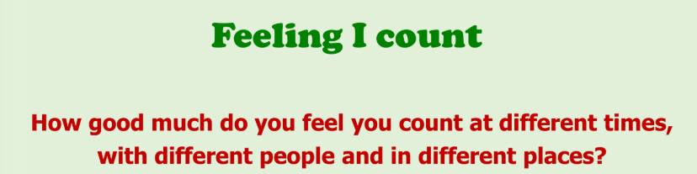
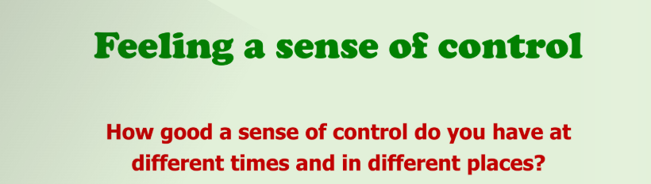
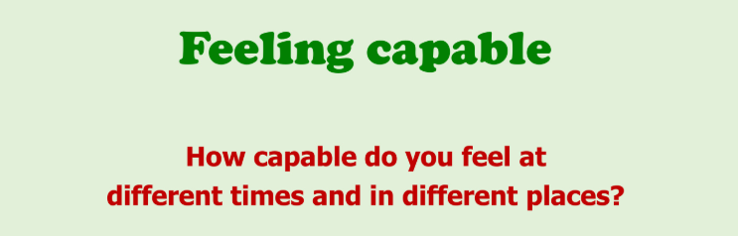

Slide 16
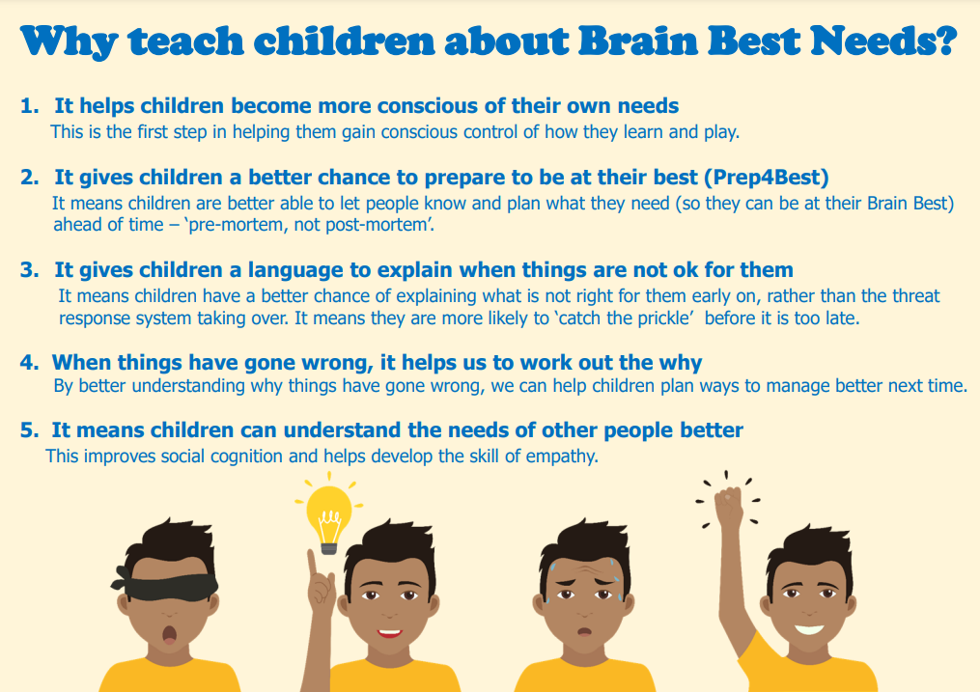

Slide 17

The Power of Goal Setting
This Photo by Unknown Author is licensed under CC BY-NC-ND

Slide 18

Benefit of setting Goals
Helps us to:
Stay focused
Keep trying, even when things are tricky
Feel proud when we achieve something
Learn that mistakes help us grow

Slide 19

How this fits in with our 5c needs
Feeling connected:
supporting each other.
Feeling Capable
Completing each stage will increase confidence
Feeling in control
Choosing your goals makes you feel excited and responsible for their success.
Feeling they count
Aceiving a goal shows children that their effort matters. Celebrating small wins boosts confidence
Feeling comfortable
When effort is encouraged, children feel safe to try even if they makes mistakes.
Motivation is what gets you started, Habit is what keeps you going

Slide 20
Congratulations
In order to have pursued an interest, developed a skill or made an achievement you or your child must have
Taken some action
Learnt how to go something
Put in some effort
When we are motivated by a goal and it’s within our skill set, it’s often easier to scheive. However,we can also meet goals by learning to create achievable steps, working through challenges and developing new skills as we go along.

Slide 21
Ideas to set our Goals/possible topics
Home
Fun

Slide 22

Preparing for the obstacles
GOAL

Slide 24
Tapping into our executive function skills

